Slide 1
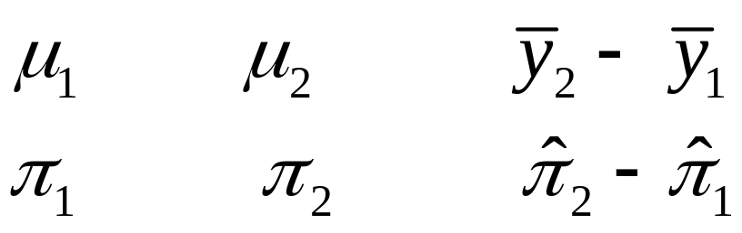
7. Comparing Two Groups
Goal: Use CI and/or significance test to compare
means (quantitative variable)
proportions (categorical variable)
Group 1 Group 2 Estimate
Population mean
Population proportion
We conduct inference about the difference between the means or difference between the proportions (order irrelevant).

Slide 2
Example: Does cell phone use while driving impair reaction times?
Article in Psych. Science (2001, p. 462) describes experiment that randomly assigned 64 Univ. of Utah students to cell phone group or control group (32 each). Driving simulating machine flashed red or green at irregular periods. Instructions: Press brake pedal as soon as possible when detect red light.
See http://www.psych.utah.edu/AppliedCognitionLab/
Cell phone group: Carried out conversation about a political issue with someone in separate room.
Control group: Listened to radio broadcast

Slide 3
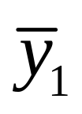

Outcome measure: mean response time for a subject over a large number of trials
Purpose of study: Analyze whether (conceptual) population mean response time differs significantly for the two groups, and if so, by how much.
Data
Cell-phone group: = 585.2 milliseconds, s₁ = 89.6
Control group: = 533.7, s₂ = 65.3.
Shape? Outliers?

Slide 4
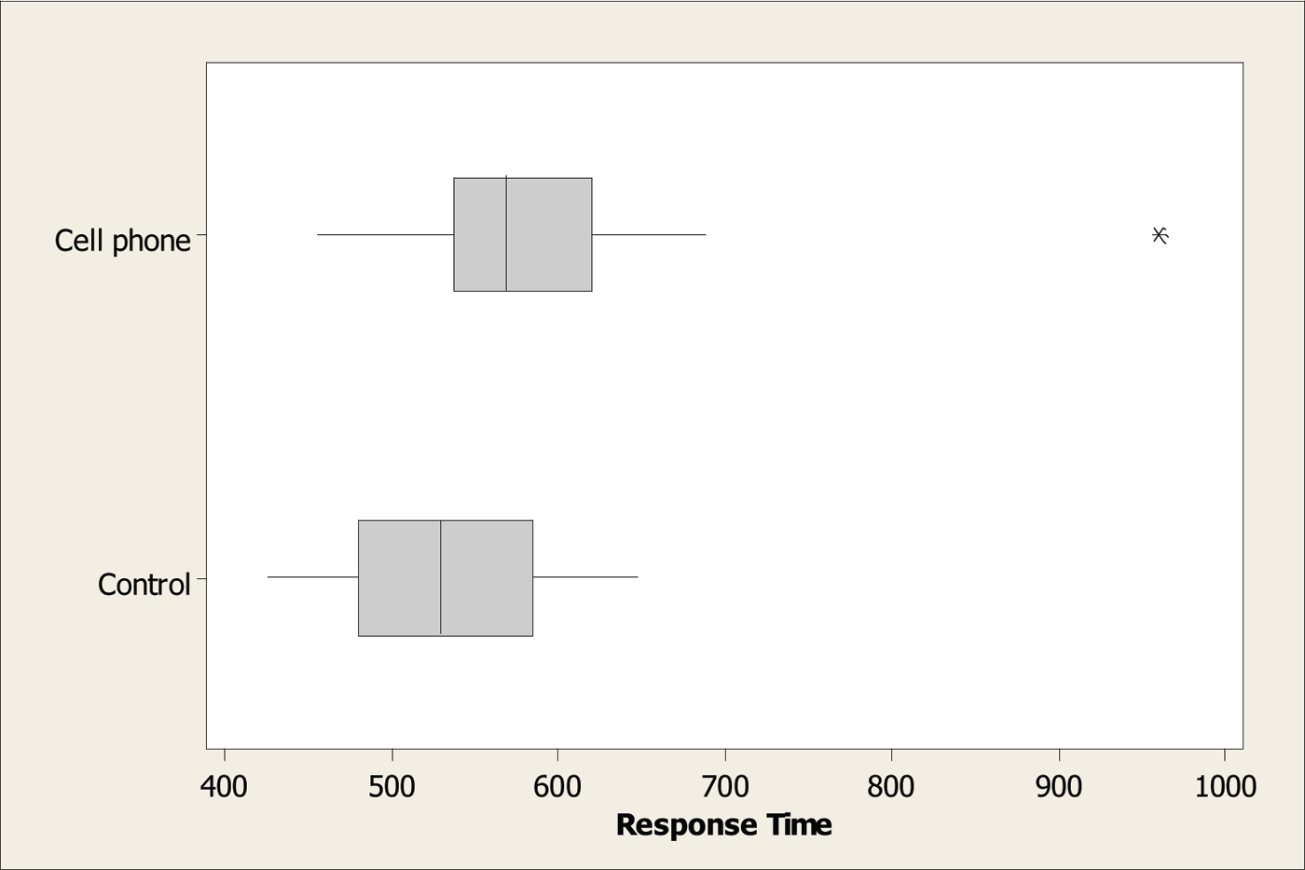

Slide 5
Types of variables and samples
The outcome variable on which comparisons are made is the response variable.
The variable that defines the groups to be compared is the explanatory variable.
Example: Reaction time is response variable
Experimental group is explanatory variable
-- a categorical var. with categories: (cell-phone, control)
Or, could express experimental group as
“cell-phone use” with categories (yes, no)

Slide 6
Different methods apply for
independent samples -- different samples, no matching, as in this example and in “cross-sectional studies”
dependent samples -- natural matching between each subject in one sample and a subject in other sample, such as in “longitudinal studies,” which observe subjects repeatedly over time
Example: We later consider a separate experiment in which the same subjects formed the control group at one time and the cell-phone group at another time.

Slide 7
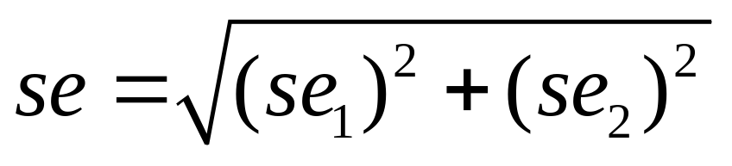
se for difference between two estimates (independent samples)
The sampling distribution of the difference between two estimates is approximately normal (large n₁ and n₂) and has estimated
Example: Data on “Response times” has
32 using cell phone with sample mean 585.2, s = 89.6
32 in control group with sample mean 533.7, s = 65.3
What is se for difference between sample means of
585.2 – 533.7 = 51.4?

Slide 8
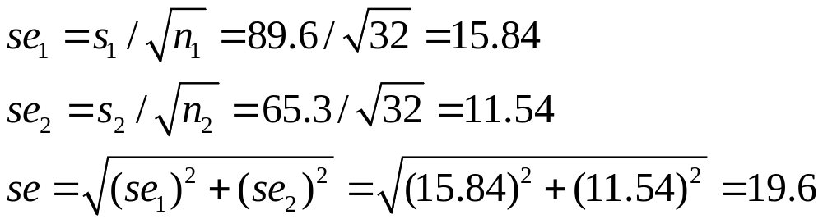
(Note this is larger than each separate se. Why?)
So, the estimated difference of 51.4 has a margin of error of about 2(19.6) = 39.2 (more precise details later using t distribution)
95% CI for μ₁ – μ₂ is about 51.4 ± 39.2, or (12, 91).
Interpretation: We are 95% confident that population mean μ₁ for cell phone group is between 12 milliseconds higher and 91 milliseconds higher than population mean μ₂ for control group.
(In practice, good idea to re-do analysis without outlier, to check its influence. What do you think would happen?)

Slide 9
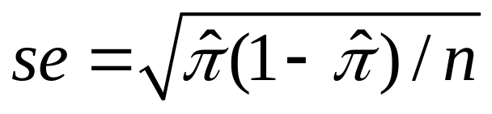
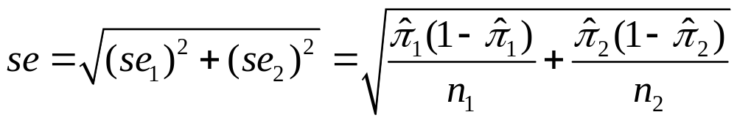
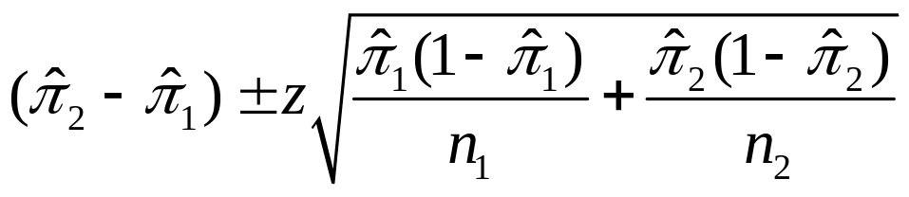
CI comparing two proportions
Recall se for a sample proportion used in a CI is
So, the se for the difference between two sample proportions for independent samples is
A CI for the difference between population proportions is
As usual, z depends on confidence level, 1.96 for 95% confidence

Slide 10
Example: College Alcohol Study conducted by Harvard School of Public Health (http://www.hsph.harvard.edu/cas/)
Trends over time in percentage of binge drinking (consumption of 5 or more drinks in a row for men and 4 or more for women, at least once in past two weeks)
and of activities perhaps influenced by it?
“Have you engaged in unplanned sexual activities because of drinking alcohol?”
1993: 19.2% yes of n = 12,708
2001: 21.3% yes of n = 8783
What is 95% CI for change saying “yes”?

Slide 11
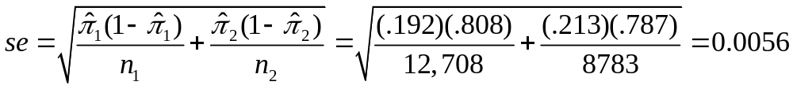
Estimated change in proportion saying “yes” is 0.213 – 0.192 = 0.021.
95% CI for change in population proportion is
0.021 ± 1.96(0.0056) = 0.021 ± 0.011, or roughly (0.01, 0.03)
We can be 95% confident that the population proportion saying “yes” was between about 0.01 larger and 0.03 larger in 2001 than in 1993.

Slide 12
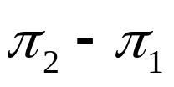
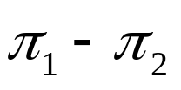
Comments about CIs for difference between two population proportions
If 95% CI for is (0.01, 0.03), then 95% CI for is (-0.03, -0.01).
It is arbitrary what we call Group 1 and Group 2 and what the order is for comparing the proportions.
When 0 is not in the CI, we can conclude that one population proportion is higher than the other.
(e.g., if all positive values for Group 2 – Group 1, then conclude population proportion higher for Group 2 than Group 1)

Slide 13
When 0 is in the CI, it is plausible that the population proportions are identical.
Example: Suppose 95% CI for change in population proportion (2001 – 1993) is (-0.01, 0.03)
“95% confident that population proportion saying yes was between 0.01 smaller and 0.03 larger in 2001 than in 1993.”
There is a significance test of H₀: ₁ = ₂ that the population proportions are identical
(i.e., difference ₁ - ₂ = 0), using test statistic
z = (difference between sample proportions)/se
For unplanned sex in 1993 and 2001,
z = diff./se = 0.021/0.0056 = 3.75
Two-sided P-value = 0.0002
This seems to be statistical significance without practical significance!

Slide 14
Details about test on pp. 189-190 of text; use se₀
which pools data to get better estimate of se under H₀
(We study this test as a special case of “chi-squared test” in next chapter, which deals with possibly many groups, many outcome categories)
The theory behind the CI uses the fact that sample proportions (and their differences) have approximate normal sampling distributions for large n’s, by the Central Limit Theorem, assuming randomization)
In practice, formula works ok if at least 10 outcomes of each type for each sample (Note: We don’t use t dist. for inference about proportions; however, there are specialized small-sample methods, e.g., using binomial distribution)

Slide 15
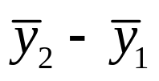
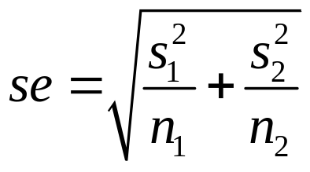
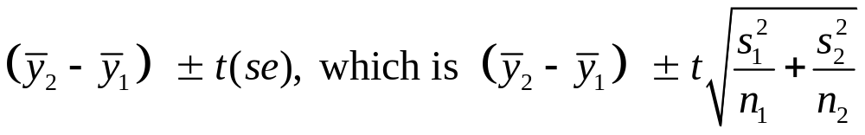
Quantitative Responses:
Comparing Means
Parameter: μ₂ - μ₁
Estimator:
Estimated standard error:
  Sampling dist.: Approximately normal (large n’s, by CLT)
  CI for independent random samples from two normal population distributions has form
  Formula for df for t-score is complex (later). If both sample sizes are at least 30, can just use z-score

Slide 16
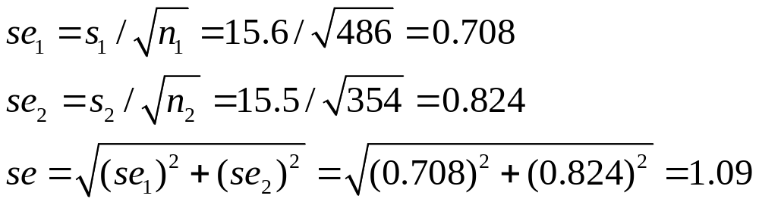
Example: GSS data on “number of close friends”
Use gender as the explanatory variable:
486 females with mean 8.3, s = 15.6
354 males with mean 8.9, s = 15.5
Estimated difference of 8.9 – 8.3 = 0.6 has a margin of error of 1.96(1.09) = 2.1, and 95% CI is
0.6 ± 2.1, or (-1.5, 2.7).

Slide 17
We can be 95% confident that the population mean number of close friends for males is between 1.5 less and 2.7 more than population mean number of close friends for females.
Order is arbitrary. 95% CI comparing means for females – males is (-2.7, 1.5)
When CI contains 0, it is plausible that the difference is 0 in the population (i.e., population means equal)
Here, normal population assumption clearly violated. For large n’s, no problem because of CLT, and for small n’s the method is robust. (But, means may not be relevant for very highly skewed data.)
Alternatively could do significance test to find strength of evidence about whether population means differ.

Slide 18
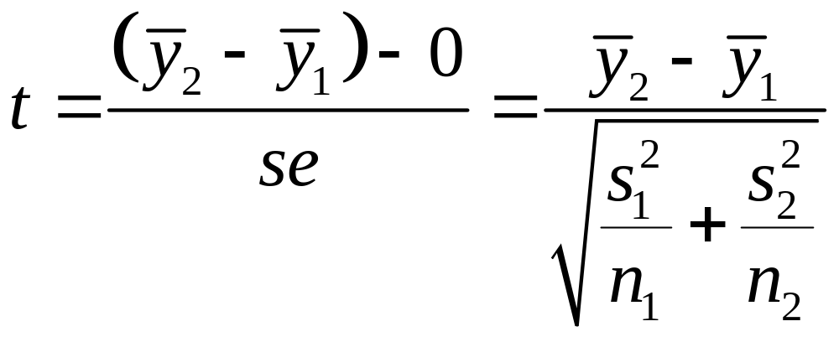
Significance Tests for μ₂ - μ₁
Typically we wish to test whether the two population means differ
(null hypothesis being no difference, “no effect”).
H₀: μ₂ - μ₁ = 0 (μ₁ = μ₂)
H_{a}: μ₂ - μ₁ ≠ 0 (μ₁ ≠ μ₂)
Test Statistic:

Slide 19
Test statistic has usual form of
(estimate of parameter – H₀ value)/standard error.
P-value: 2-tail probability from t distribution
For 1-sided test (such as H_{a}: μ₂ - μ₁ > 0), P-value = one-tail probability from t distribution (but, not robust)
Interpretation of P-value and conclusion using -level same as in one-sample methods
ex. Suppose P-value = 0.58. Then, under supposition that null hypothesis true, probability = 0.58 of getting data like observed or even “more extreme,” where “more extreme” determined by H_{a}

Slide 20
Example: Comparing female and male mean number of close friends, H₀: μ₁ = μ₂ H_{a}: μ₁ ≠ μ₂
Difference between sample means = 8.9 – 8.3 = 0.6
se = 1.09 (same as in CI calculation)
Test statistic t = 0.6/1.09 = 0.55
P-value = 2(0.29) = 0.58 (using standard normal table)
If H₀ true of equal population means, would not be unusual to get samples such as observed.
For  = 0.05 = P(Type I error), not enough evidence to reject H₀. (Plausible that population means are identical.)
For H_{a}: μ₁ < μ₂ (i.e., μ₂ - μ₁ > 0), P-value = 0.29
For H_{a}: μ₁ > μ₂ (i.e., μ₂ - μ₁ < 0), P-value = 1 – 0.29 = 0.71

Slide 21
Equivalence of CI and Significance Test
“H₀: μ₁ = μ₂ rejected (not rejected) at  = 0.05 level in favor of H_{a}: μ₁ ≠ μ₂”
is equivalent to
“95% CI for μ₁ - μ₂ does not contain 0 (contains 0)”
Example: P-value = 0.58, so “We do not reject H₀ of equal population means at 0.05 level”
95% CI of (-1.5, 2.7) contains 0.
(For  other than 0.05, corresponds to 100(1 - )% confidence)

Slide 22
Alternative inference comparing means assumes equal population standard deviations
We will not consider formulas for this approach here (in Sec. 7.5 of text), as it’s a special case of “analysis of variance” methods studied later in Chapter 12.
This CI and test uses t distribution with
df = n₁ + n₂ - 2
We will see how software displays this approach and the one we’ve used that does not assume equal population standard deviations.

Slide 23
Example: Exercise 7.30, p. 213. Improvement scores for
therapy A: 10, 20, 30
therapy B: 30, 45, 45
A: mean = 20, s₁ = 10
B: mean = 40, s₂ = 8.66
Data file, which we input into SPSS and analyze
Subject Therapy Improvement
1 A 10
2 A 20
3 A 30
4 B 30
5 B 45
6 B 45

Slide 24
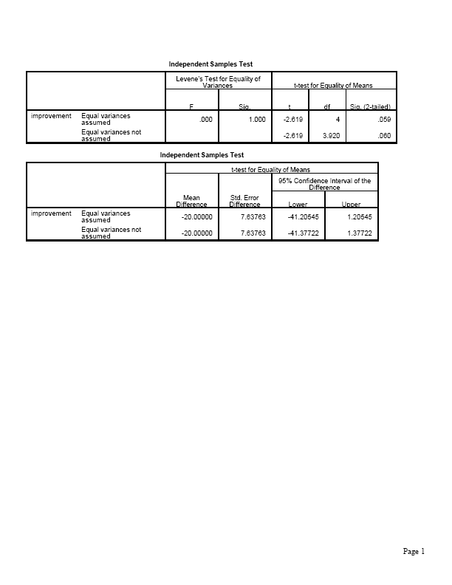

Slide 25
Test of H₀: μ₁ = μ₂ H_{a}: μ₁ ≠ μ₂
Test statistic t = (40 – 20)/7.64 = 2.62
When df = 4, P-value = 2(0.0294) = 0.059.
For one-sided H_{a}: μ₁ < μ₂ (i.e., predict before study that therapy B is better), P-value = 0.029
With  = 0.05, insufficient evidence to reject null for two-sided H_{a}, but can reject null for one-sided H_{a} and conclude therapy B better.
(but remember, must choose H_{a} ahead of time!)

Slide 26

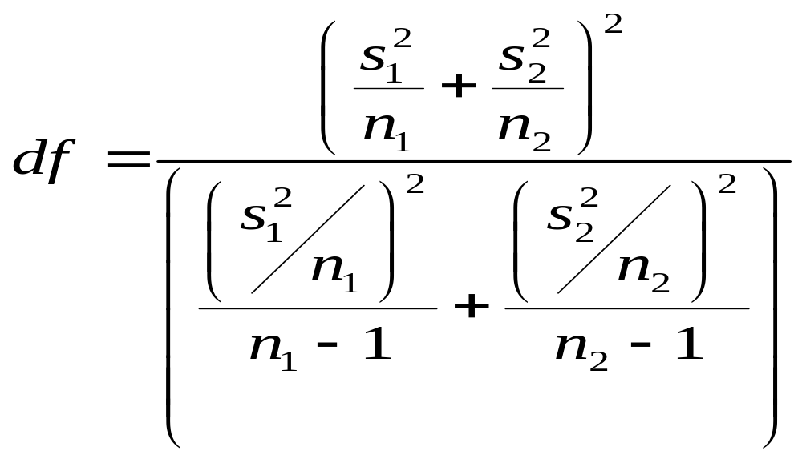
How does software get df for “unequal variance” method?
When allow σ₁² ≠ σ₂² recall that
The “adjusted” degrees of freedom for the t distribution approximation is (Welch-Satterthwaite approximation) :

Slide 27
Some comments about comparing means
If data show potentially large differences in variability (say, the larger s being at least double the smaller s), safer to use the “unequal variances” method
One-sided t tests not robust against severe violations of normal population assumption, when n is small. Better then to use “nonparametric” methods (which do not assume a particular form of population distribution) for one-sided inference; see text Sec. 7.7.
CI more informative than test, showing whether plausible values are near or far from H₀.

Slide 28
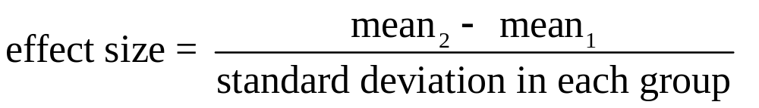
Effect Size
When groups have similar variability, a summary measure of effect size is
Example: The therapies had sample means of 20 for A and 40 for B and standard deviations of 10 and 8.66. If common standard deviation in each group is estimated to be s = 9.35 (say), then
effect size = (40 – 20)/9.35 = 2.1.
Mean for therapy B estimated to be about two standard deviations larger than the mean for therapy A.
This is a large effect.

Slide 29
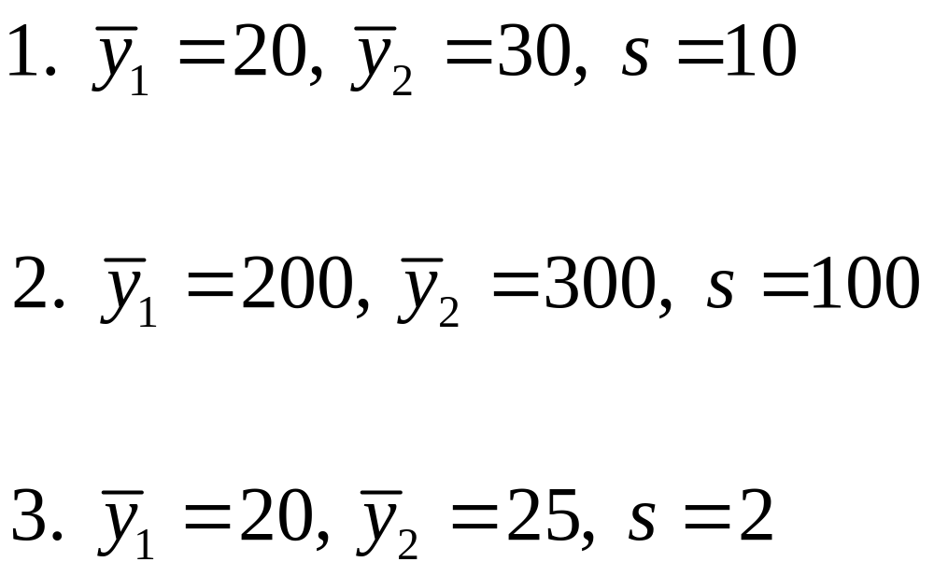
This effect size measure is sometimes called “Cohen’s d.” He considered d = 0.2 = weak, d = 0.5 = medium, d > 0.8 large.
Example: Which study showed the largest effect?

Slide 30
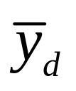
Comparing Means with Dependent Samples
Setting: Each sample has the same subjects (as in longitudinal studies or crossover studies) or matched pairs of subjects
Then, it is not true that for comparing two statistics,
Must allow for “correlation” between estimates (Why?)
Data: y_{i} = difference in scores for subject (pair) i
Treat data as single sample of difference scores, with sample mean and sample standard deviation s_{d} and parameter μ_{d} = population mean difference score.
In fact, μ_{d} = μ₂ – μ₁

Slide 31
Example: Cell-phone study also had experiment with same subjects in each group
(data on p. 194 of text)
For this “matched-pairs” design, data file has the form
Subject Cell_no Cell_yes
1 604 636
2 556 623
3 540 615
… (for 32 subjects)
Sample means are 534.6 milliseconds without cell phone
585.2 milliseconds, using cell phone

Slide 32
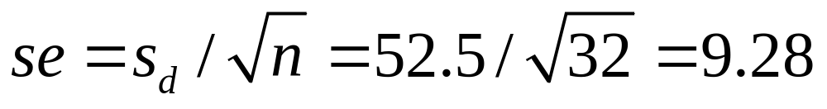
We reduce the 32 observations to 32 difference scores,
636 – 604 = 32
623 – 556 = 67
615 – 540 = 75
….
and analyze them with standard methods for a single sample
= 50.6 = 585.2 – 534.6, s_{d} = 52.5 = std dev of 32, 67, 75 …
For a 95% CI, df = n – 1 = 31, t-score = 2.04
We get 50.6 ± 2.04(9.28), or (31.7, 69.5)

Slide 33
We can be 95% confident that the population mean using a cell phone is between 31.7 and 69.5 milliseconds higher than without cell phone.
For testing H₀ : µ_{d} = 0 against H_{a} : µ_{d} ≠ 0, the test statistic is
t = ( - 0)/se = 50.6/9.28 = 5.46, df = 31,
Two-sided P-value = 0.0000058, so there is extremely strong evidence against the null hypothesis of no difference between the population means.

Slide 34
In class, we will use SPSS to
Run the dependent-samples t analyses
Plot cell_yes against cell_no and observe a strong positive correlation (0.814), which illustrates how an analysis that ignores the dependence between the observations would be inappropriate.
Note that one subject (number 28) is an outlier (unusually high) on both variables
With outlier deleted, SPSS tell us that t = 5.26, df = 30 for comparing means (P = 0.00001) for comparing means, 95% CI of (29.1, 66.0). The previous results were not influenced greatly by the outlier.

Slide 35
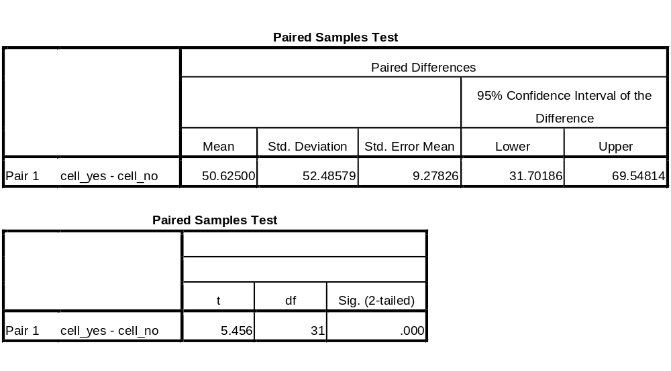
SPSS output for original dependent-samples t analysis (including the outlier)

Slide 36
Some comments
Dependent samples have advantages of (1) controlling sources of potential bias (e.g., balancing samples on variables that could affect the response), (2) having a smaller se for the difference of means, when the pairwise responses are highly positively correlated (in which case, the difference scores show less variability than the separate samples)
With dependent samples, why can’t we use the se formula for independent samples?

Slide 37
Ex. (artificial, but makes the point)
Weights before and after anorexia therapy
Subject Before After Difference
1 115 122 7
2 91 98 7
3 100 107 7
4 132 139 7
…
Lots of variability within each group of observations, but no variability for the difference scores (so, actual se is much smaller than independent samples formula suggests)
If you plot x = before against y = after, what do you see?

Slide 38
The McNemar test (pp. 201-203) compares proportions with dependent samples
Fisher’s exact test (pp. 203-204) compares proportions for small independent samples
Sometimes it’s more useful to compare groups using ratios rather than differences of parameters

Slide 39
Example: U.S. Dept. of Justice reports that proportion of adults in prison is about
900/100,000 for males, 60/100,000 for females
Difference: 900/100,000 – 60/100,000 = 840/100,000 = 0.0084
Ratio: [900/100,000]/[60/100,000] = 900/60 = 15.0
In applications in which the proportion refers to an undesirable outcome (e.g., most medical studies), the ratio is called the relative risk. Inference methods (CI, test) are available for it also.

Slide 40
A few summary questions
Give an example of (a) independent samples, (b) dependent samples
Give an example of (a) response var., (b) categorical explanatory var., and identify whether response is quantitative or categorical and state the appropriate analyses.
3. Suppose that a 95% CI for difference between Massachusetts and Texas in the population proportion supporting legal same-sex marriage is (0.15, 0.22).
Population proportion of support is higher in Texas
Since 0.15 and 0.22 < 0.50, less than half the population supports legal same-sex marriage.
The 99% CI could be (0.17, 0.20)
It is plausible that population proportions are equal.
P-value for testing equal population proportions against two-sided alternative could be 0.40.
We can be 95% confident that the population proportion of
support in MA is between 0.15 higher and 0.22 higher than in TX.

Slide 41
Example: Anorexia study, studying weight change for 3 groups (behavioral therapy, family therapy, control). Patients randomly assigned to one of the three therapies. Is this an example of independent samples or dependent samples?

